Slide 1
QXU4004 Molecules to Materials
Dr Sulafudin Vukusic
s.vukusic@qmul.ac.uk

Slide 2
Suggested Reading List:
Chapter 1, 2, 6: Brown et al. Chemistry the central science,14th int Ed, Pearson / ISBN:978-1-292-02152-2
https://www-vlebooks-com.ezproxy.library.qmul.ac.uk/vleweb/Product/Index/979714?page=0
(See QMPLUS for link)

Slide 3
Notes 1: Atoms to Materials…
Atomic Orbitals and Basic
Quantum Mechanics

Slide 4
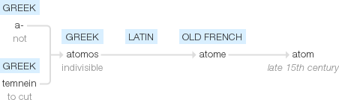
Atoms!
Google: Atom etymology
http://www.etymonline.com → Atom (n): late 15c., as a hypothetical indivisible extremely minute body, the building block of the universe, from Latin atomus (especially in Lucretius) "indivisible particle," from Greek atomos "uncut, unhewn; indivisible," from a- "not" + tomos "a cutting," from temnein "to cut". An ancient term of philosophical speculation (in Leucippus, Democritus); revived scientifically 1805 by British chemist John Dalton. In late classical and medieval use also a unit of time, 22,560 to the hour.

Slide 5
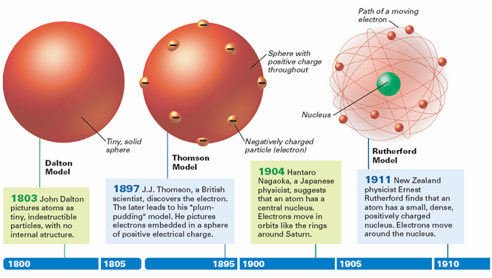
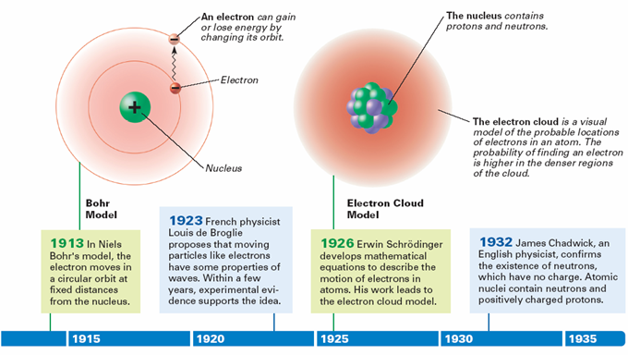

Slide 6

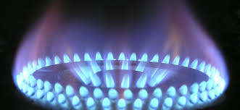
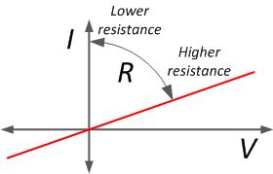
Understanding energy…
From our every day experience

Slide 7

Quantum Theory
1900 - Max Planck
Radiant energy could only be emitted or absorbed in discrete quantities (“chunks”)
Quantum: packets of energy
Revolutionized way of thinking (energy is “quantised”)

Slide 9
The Nature of Light
The electromagnetic spectrum includes many different types of radiation.
Visible light accounts for only a small part of the spectrum
Other familiar forms include: radio waves, microwaves, X rays
All forms of light travel in waves

Slide 10
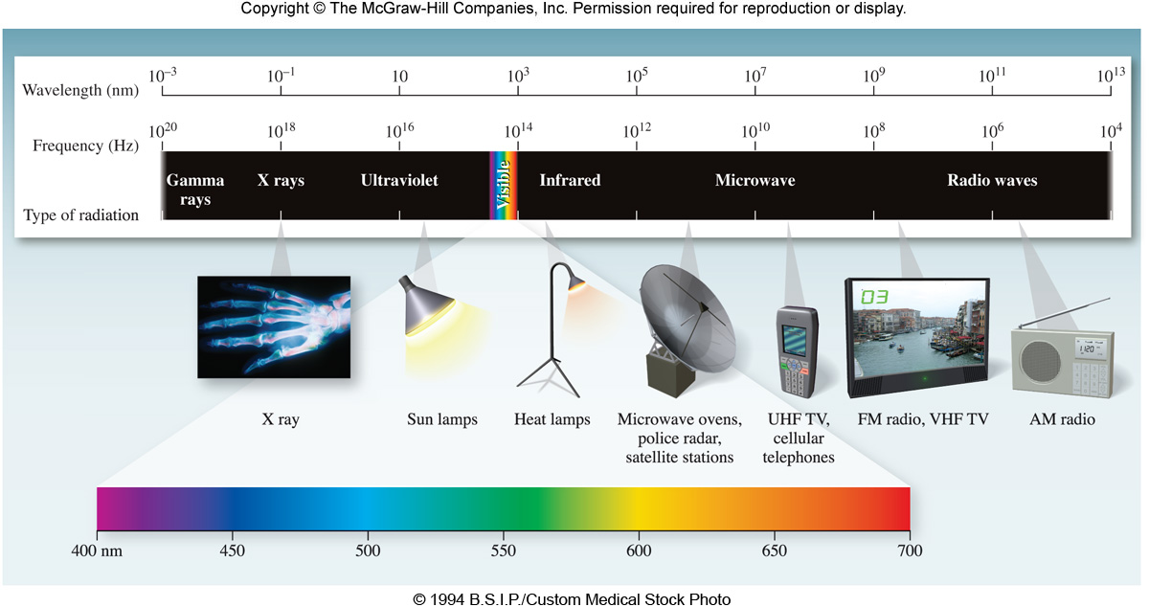
Electromagnetic Spectrum
Figure 06.01Figure 06.01

Slide 11
Wave Characteristics
Wavelength: λ (lambda) distance between identical points on successive waves…peaks or troughs
Frequency:ν (nu) number of waves that pass a particular point in one second
Amplitude: the vertical distance from the midline of waves to the top of the peak or the bottom of the trough

Slide 12
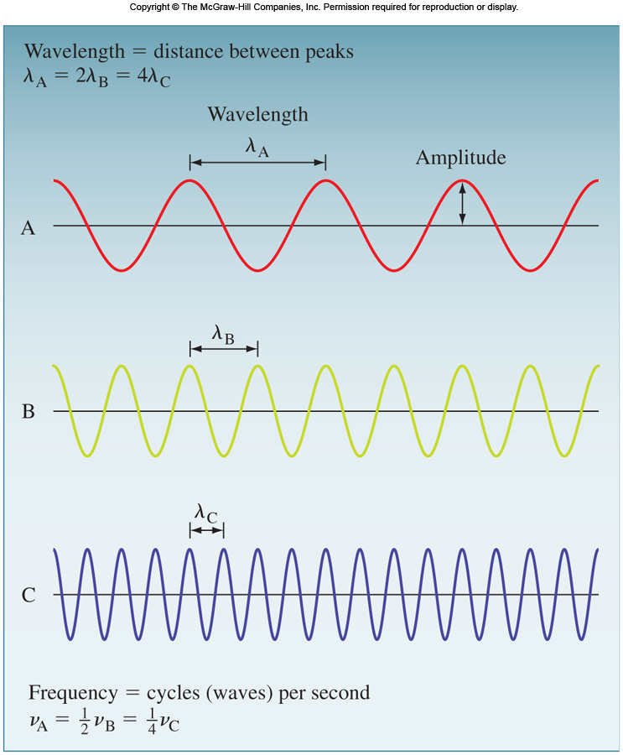

Slide 17
Wave Characteristics
Wave properties are mathematically related as:
c = λν
where
c = 2.99792458 x 10⁸ m/s (speed of light)‏
λ = wavelength (in meters, m)
ν = frequency (reciprocal seconds, s⁻¹)

Slide 18
Wave Calculation
The wavelength of a laser pointer is reported
to be 663 nm. What is the frequency of this
light? c = λν

Slide 19
Calculate the wavelength of light, in nm,
of light with a frequency of 3.52 x 10¹⁴ s⁻¹.
c = λν

Slide 20
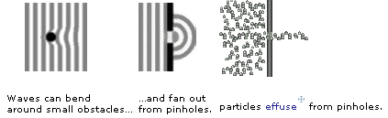
Waves vs Particles
Waves can bend
around small obstacles…
…and fan out
from pinholes.
Particles effuse from pinholes
Three ways to tell a wave from a particle…
wave behavior particle behavior
waves interfere particle collide
waves diffract particles effuse
waves are delocalized particles are localized

Slide 21
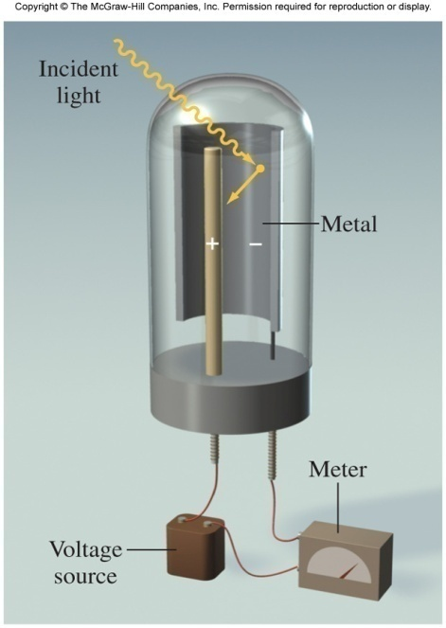
Photoelectric Effect
Electrons ejected from a metal’s surface when exposed to light of certain frequency
Einstein proposed that particles of light are really photons (packets of light energy) and deduced that
E_{photon} = hν

Slide 22
Quantum Theory
Energy of a single quantum of energy
where
E = energy (in Joules)
h = Planck’s constant 6.63 x 10⁻³⁴ J ⋅ s
ν = frequency

Slide 23
Only light with a frequency of photons such that hν equals the energy that binds the electrons in the metal is sufficiently energetic to eject electrons.
If light of higher frequency is used, electrons will be ejected and will leave the metal with additional kinetic energy.
(what is the relationship between energy and frequency?)
Light of at least the threshold frequency and of greater intensity will eject more electrons.

Slide 24
Calculate the energy (in joules) of a photon
with a wavelength of 700.0 nm
c = λν

Slide 25
Calculate the wavelength (in nm) of light
with energy 7.83 x 10⁻¹⁹ J per photon. In
what region of the electromagnetic
radiation does this light fall?
c = λν
Ultraviolet region

Slide 26
Photoelectric Effect
Dilemma caused by this theory - is light a wave or particle?
Conclusion: Light must have particle characteristics as well as wave characteristics

Slide 27
Atomic Line Spectra
Line spectra: emission of light only at specific wavelengths
Every element has a unique emission spectrum
Often referred to as “fingerprints” of the element

Slide 28
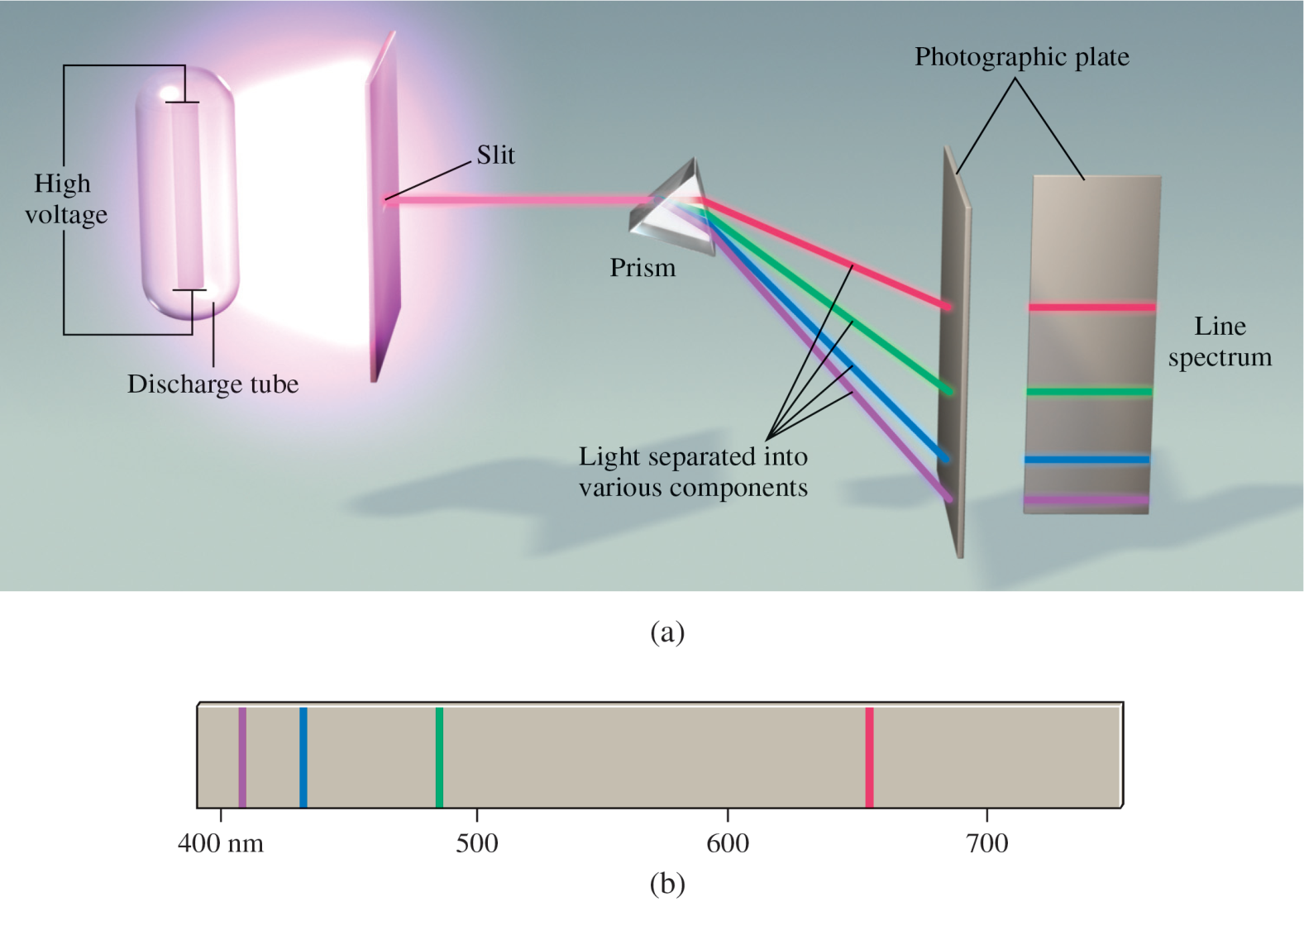
Atomic Line Spectra

Slide 29
Bright-line Spectra

Slide 30
Line Spectrum of Hydrogen
Each spectral line corresponds to a specific electron transition
Electrons moving from ground state to higher states require energy; an electron falling from a higher to a lower state releases energy

Slide 31
Wave Properties of Matter
Louis de Broglie (1924) reasoned that if energy (light) can behave as a particle (photon) then perhaps particles (electrons) could exhibit wave characteristics

Slide 32
Wave Properties of Matter
De Broglie proposed that electrons in atoms behave as standing waves (like the wave created when a guitar string is plucked)
There are some points called nodes (where the wave exhibits no motion at all)

Slide 33
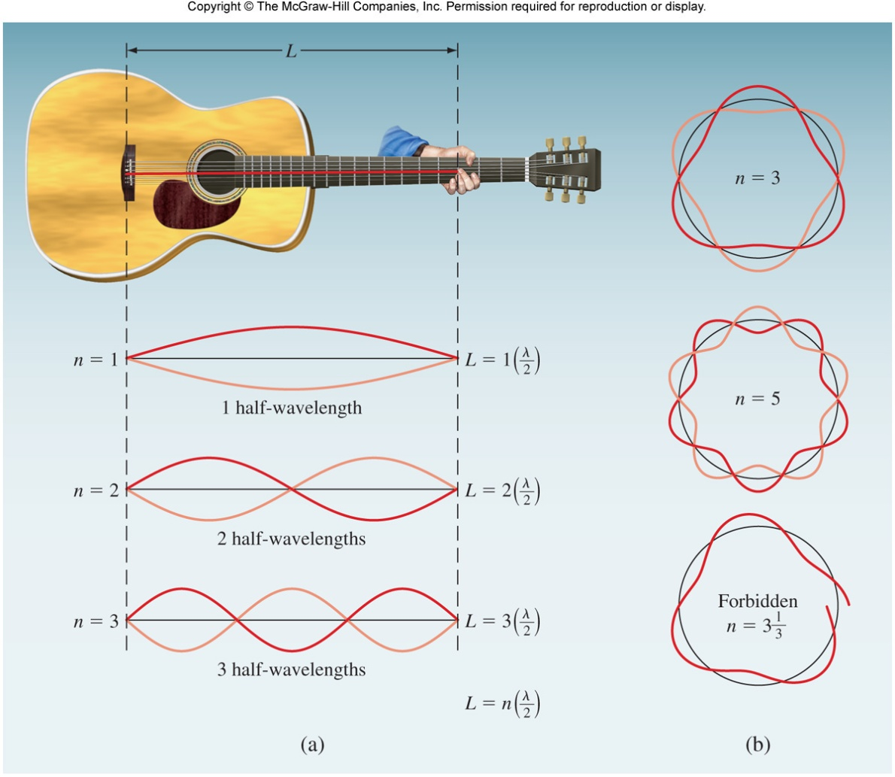
Wave Properties of Matter

Slide 34
Wave Properties of Matter
De Broglie’s idea of particle and wave properties are related by the following
where λ = wavelength
m = mass (kg)
u = velocity (m/s)

Slide 35
Calculate the de Broglie wavelength of
the “particle” in the following two cases:
A 25.0 g bullet traveling at 612 m/s
An electron (mass = 9.109 x 10⁻³¹kg) moving at 63.0 m/s
Note: 1 Joule = 1 kg ⋅ m²/s²

Slide 36
A 25.0 g bullet traveling at 612 m/s
An electron (mass = 9.109 x 10⁻³¹ kg)
moving at 63.0 m/s
* Wavelengths of macroscopic particles are imperceptibly small and really have no physical significance.
36

Slide 37
Quantum Mechanics
Scientists yearned to understand exactly where electrons are in an atom.
Heisenberg’s uncertainty principle mathematically described the position and velocity of an electron. The more you know about one, the less you are sure about the other quantity.

Slide 38
Quantum Mechanics
Heisenberg disproved Bohr’s model of defined orbits for electrons
Bohr’s theory did not provide a clear description
Erwin Schrödinger, derived a complex mathematical formula to incorporate wave and particle characteristics

Slide 39
Quantum Mechanics
Quantum mechanics (wave mechanics)
Does not allow us to specify exact location of electrons, we can predict high probability of finding an electron
Use the term atomic orbital instead of “orbit” to describe the electron’s position within the atom

Slide 40
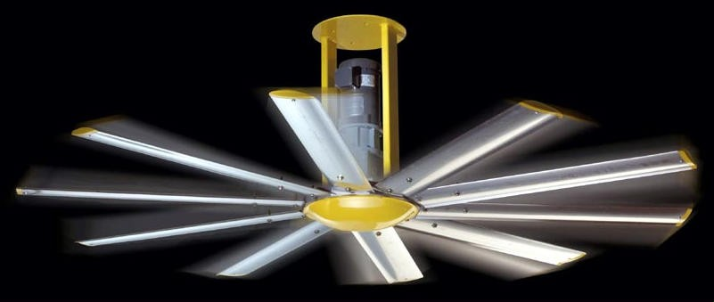
The electron as a wave
Schrödinger’s wave equation
Used to determine the probability of finding the H electron at any given distance from the nucleus
Electron best described as a cloud
Effectively covers all points at the same time
(fan blades)
Notes:
http://news.thomasnet.com/images/large/465/465828.jpg

Slide 41
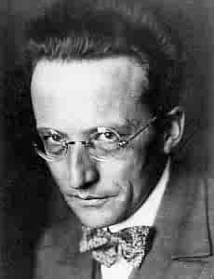
Quantum Mechanics
Erwin Schrödinger
~1926
Schrödinger Wave Equation (1926)
finite # of solutions ⇒ quantized energy levels
Related (but not quite the same) to the probability of finding an electron
Comes in many different forms - one example:
Courtesy Christy Johannesson www.nisd.net/communicationsarts/pages/chem

Slide 42
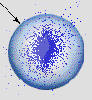
Quantum Mechanics
Orbital (“electron cloud”)
Orbitals (Ψ) are the wave functions
Probability density (Ψ²)
Orbital, related to the region in space where there is >90% probability of finding an electron
Electron Probability vs. Distance
40
30
20
Electron Probability (%)
10
0
0
50
100
150
200
250
Distance from the Nucleus (pm)
Orbital
Courtesy Christy Johannesson www.nisd.net/communicationsarts/pages/chem

Slide 43
Quantum Numbers
Each atomic orbital in an atom is characterized by a unique set of three quantum numbers (from Schrödinger’s wave equation)
n, l, and m_{l}

Slide 44
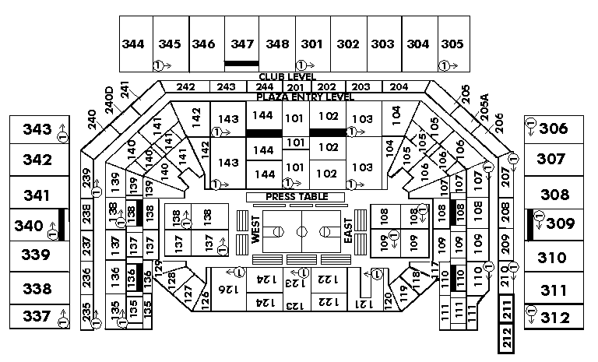
Quantum Numbers
Quantum Numbers:
Specify the “address” of each electron in an atom
UPPER LEVEL
Courtesy Christy Johannesson www.nisd.net/communicationsarts/pages/chem

Slide 45
Quantum Numbers
Principal quantum number (n) - designates size of the orbital
Integer values: 1,2,3, and so forth
The larger the “n” value, the greater the average distance from the nucleus
Correspond to quantum numbers in Bohr’s model

Slide 46
Quantum Numbers
Angular momentum quantum number (l) - describes the shape of the atomic orbital
Integer values: 0 to n − 1
0 = s sublevel; 1 = p; 2 = d; 3 = f

Slide 47
Quantum Numbers
Magnetic quantum number (m_{l}) - describes the orientation of the orbital in space (think in terms of x, y and z axes)
Integer values: − l to 0 to + l

Slide 48
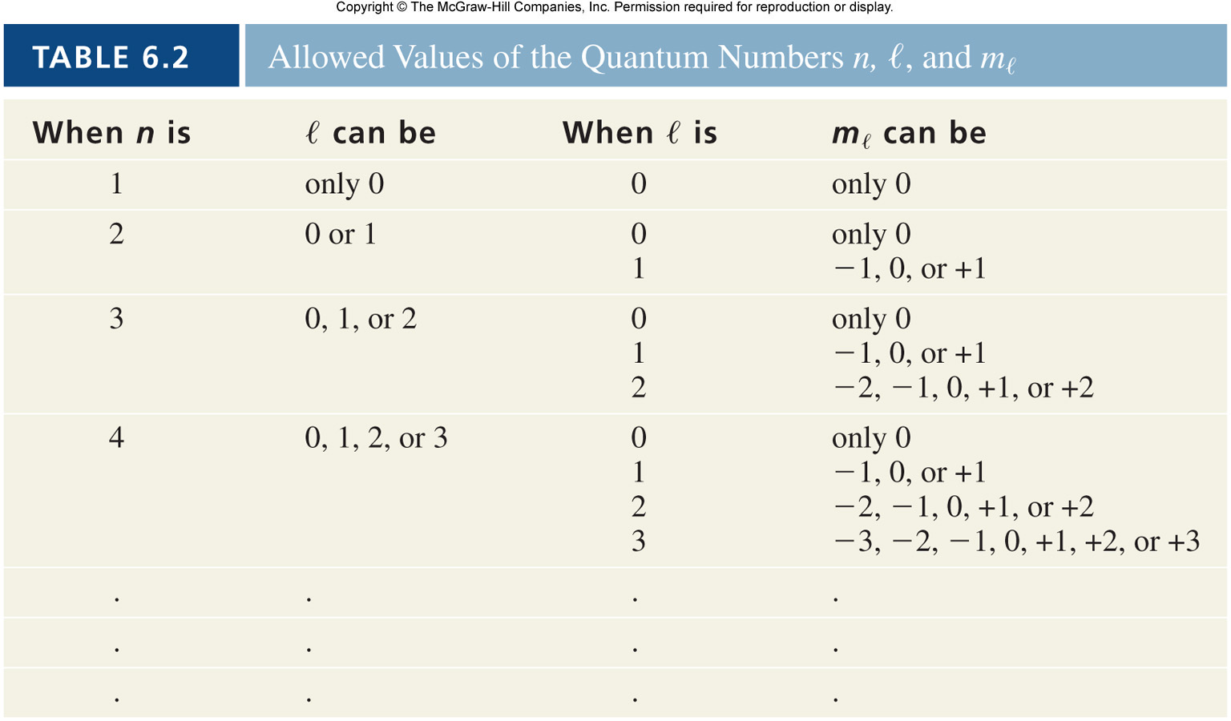
Quantum Numbers

Slide 49
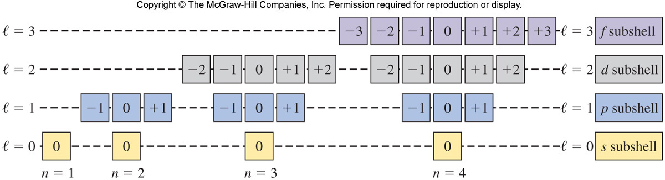
Quantum Numbers
m_{l}

Slide 50
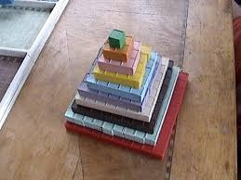

Slide 51
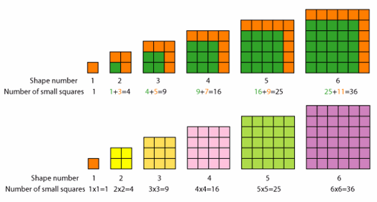

Slide 52
Quantum Numbers
Electron spin quantum number (m_{s}) - describes the spin of an electron that occupies a particular orbital
Values: +1/2 or −1/2
Electrons will spin opposite each other in the same orbital

Slide 53


Quantum Numbers
Spin Quantum Number ( m_{s} )
Electron spin ⇒ +½ or -½
An orbital can hold 2 electrons that spin in opposite directions.
Courtesy Christy Johannesson www.nisd.net/communicationsarts/pages/chem

Slide 54
Electron Spin: The Fourth Quantum Number
When an electrically charged object spins, it produces a magnetic moment parallel to the axis of rotation and behaves like a magnet.
A magnetic moment is called electron spin.
An electron has two possible orientations in an external magnetic field, which are described by a fourth quantum number m_{s}.
For any electron, m_{s} can have only two possible values, designated + (up) and – (down), indicating that the two orientations are opposite and the subscript s is for spin.
An electron behaves like a magnet that has one of two possible orientations, aligned either with the magnetic field or against it.
Copyright © 2006 Pearson Benjamin Cummings. All rights reserved.

Slide 55
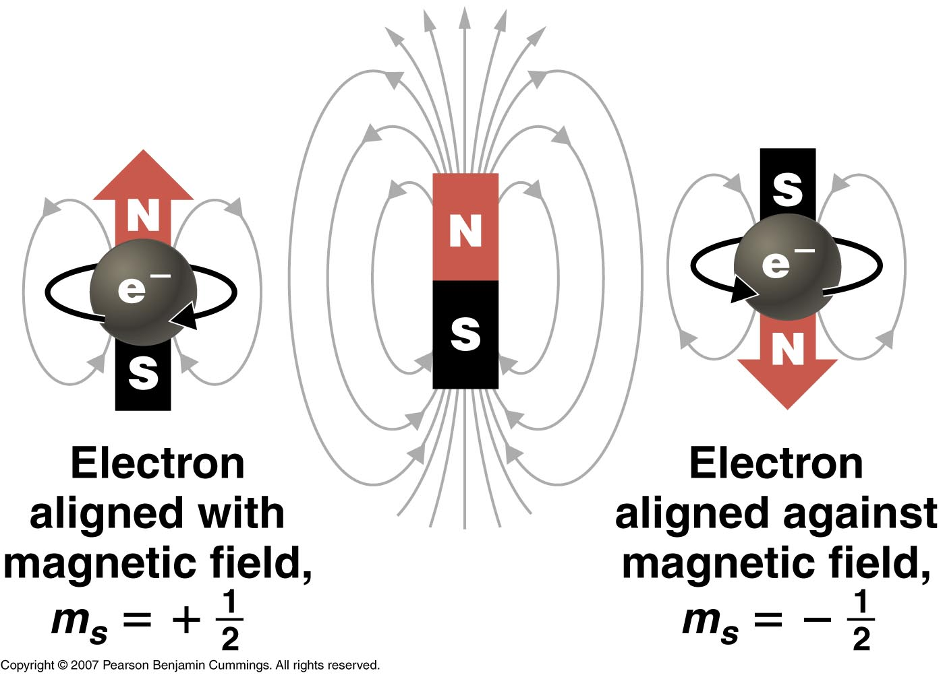
Copyright © 2006 Pearson Benjamin Cummings. All rights reserved.

Slide 56
Quantum Numbers
Which of the following are possible sets of
quantum numbers?
a) 1, 1, 0, +1/2
b) 2, 0, 0, +1/2
c) 3, 2, −2, −1/2

Slide 57
Quantum Numbers
Which of the following are possible sets of
quantum numbers?
a) 1, 1, 0, +1/2 l value not possible
b) 2, 0, 0, +1/2 possible
c) 3, 2, −2, −1/2 possible

Slide 58
Atomic Orbitals
“Shapes” of atomic orbitals
“s” orbital - spherical in shape
“p” orbitals - two lobes on opposite sides of the nucleus
“d” orbitals - more variations of lobes
“f” orbitals - complex shapes

Slide 59
Quantum Numbers
1. Principal Quantum Number ( n )
Energy level
Size of the orbital
n² = # of orbitals in the energy level
1s
2s
3s
Courtesy Christy Johannesson www.nisd.net/communicationsarts/pages/chem

Slide 60
Relative Sizes 1s and 2s
1s 2s
Zumdahl, Zumdahl, DeCoste, World of Chemistry 2002, page 334

Slide 61
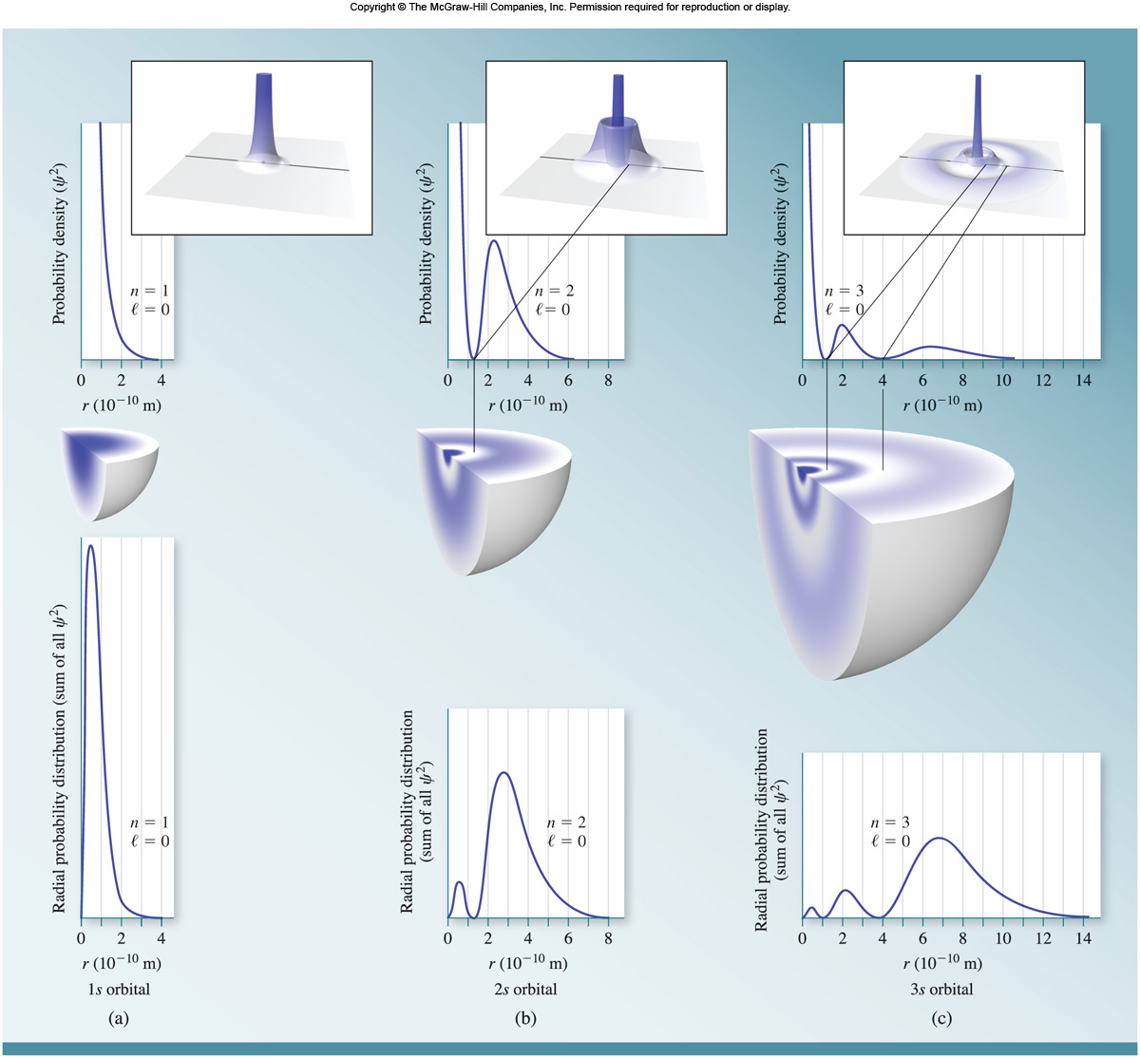
Probability Density and Radial Probability for “s” Orbitals
Orbital: wave function (Ψ)
Probability density: Ψ²

Slide 62
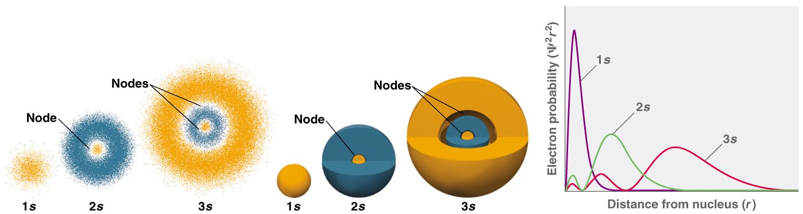
(a) Electron probability (b) Contour probability (c) Radial probability
Radial nodes
Copyright © 2006 Pearson Benjamin Cummings. All rights reserved.
Notes:
An Orbital — is the quantum mechanical refinement of Bohr’s orbit
Orbitals are mathematically derived regions of space with different probabilities of containing the electron
The different ways of representing electron probability distributions are
1. Because ψ² gives the probability of finding the electron in a given volume of space, a plot of ψ² versus distance from the nucleus, r, is a plot of the probability density.
Probability density is greatest at r = 0 (at the nucleus) and decreases steadily with increasing distance
2. The radial probability can be calculated by summing the probabilities of the electron being at all points on a series of x spherical shells of radius r₁, r₂ …r_{x −1}, r_{x} and
calculating the probability of finding the electron in each of the spherical shells.

Slide 63
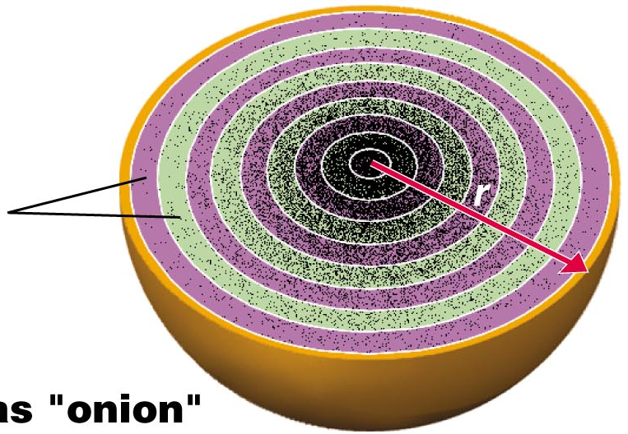
S orbitals imagined as “onions”
Concentric spherical shells
Copyright © 2006 Pearson Benjamin Cummings. All rights reserved.

Slide 65
Atomic Orbitals
Drum mode (Think of vibrations in a drum membrane)
Wave function of 1s orbital
Subsequently, the drum modes equivalent to orbital wave functions will be shown as they are more distinctive to show the relevant features.

Slide 66
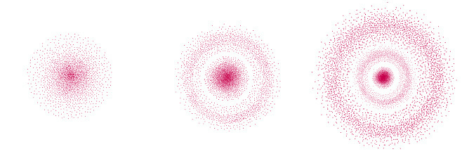
Probability density: Ψ²
Ψ²1s
Ψ²2s
Ψ²3s
r
r
r
r
r
r
Distance from nucleus
Orbital: wave function (Ψ)
(a) 1s (b) 2s (c) 3s

Slide 67
Atomic Orbitals
Equivalent drum modes
A B C
Wave function of 1s orbital
Wave function of 2s orbital
Wave function of 3s orbital

Slide 68
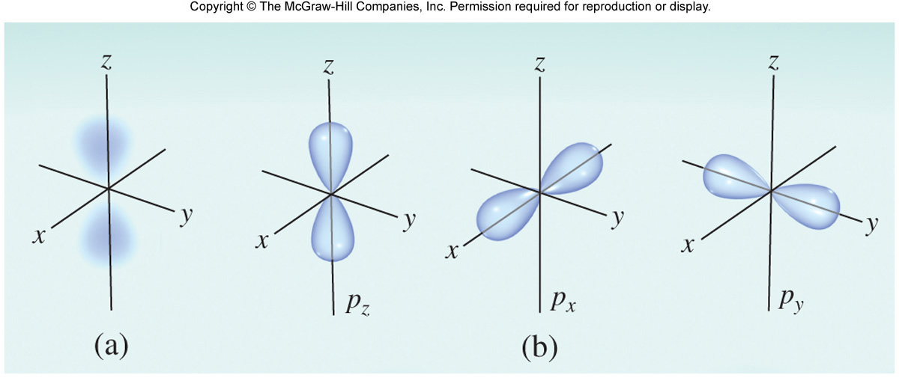
Atomic Orbitals for “p”

Slide 69
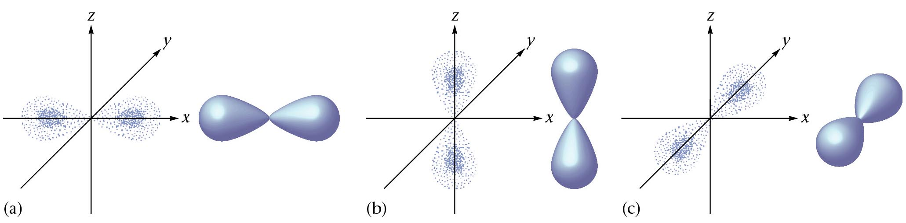
p-Orbitals
p_{x}
p_{z}
p_{y}
Zumdahl, Zumdahl, DeCoste, World of Chemistry 2002, page 335

Slide 70
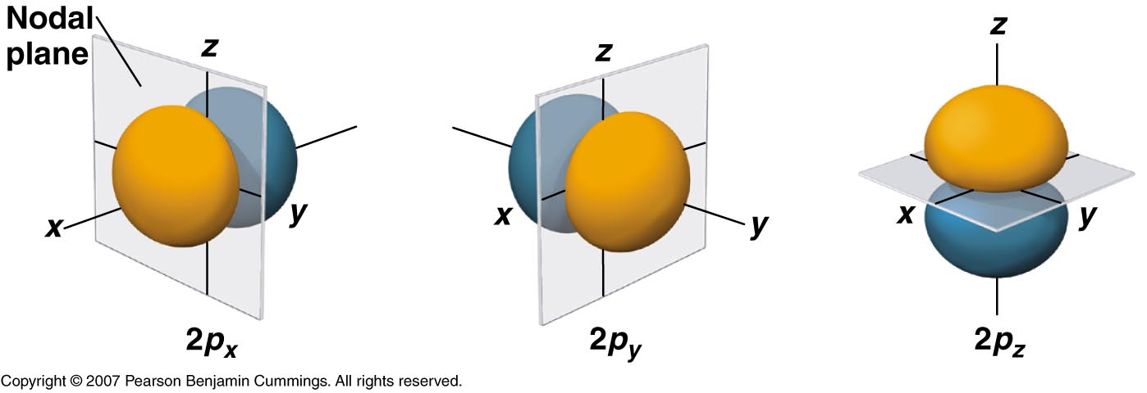
Planar or angular nodes
Number of nodes: n-1
Number of angular or planar nodes: l
Number of radial nodes: n-l-1
Copyright © 2006 Pearson Benjamin Cummings. All rights reserved.

Slide 71
Atomic Orbitals
Equivalent drum modes
A B C
Wave function of 2p orbital
Wave function of 3p orbital
Wave function of 4p orbital

Slide 72
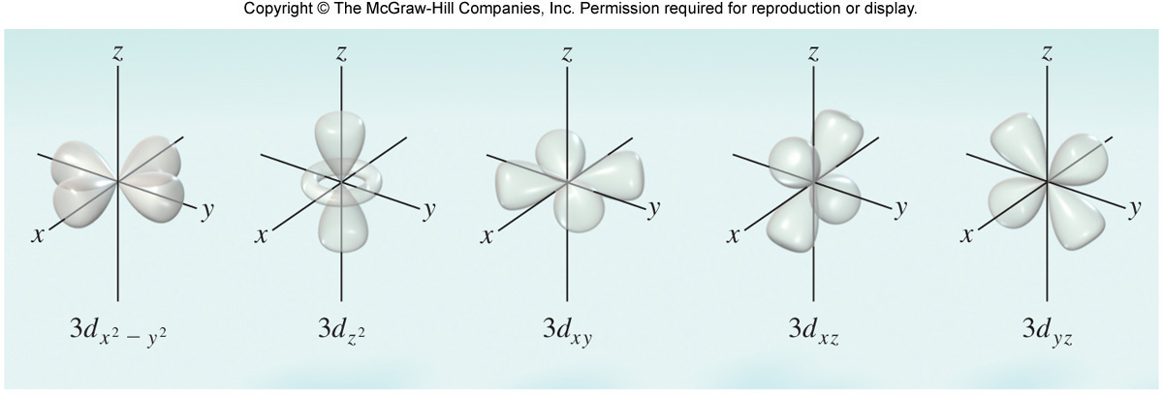
Atomic Orbitals for “d”

Slide 73
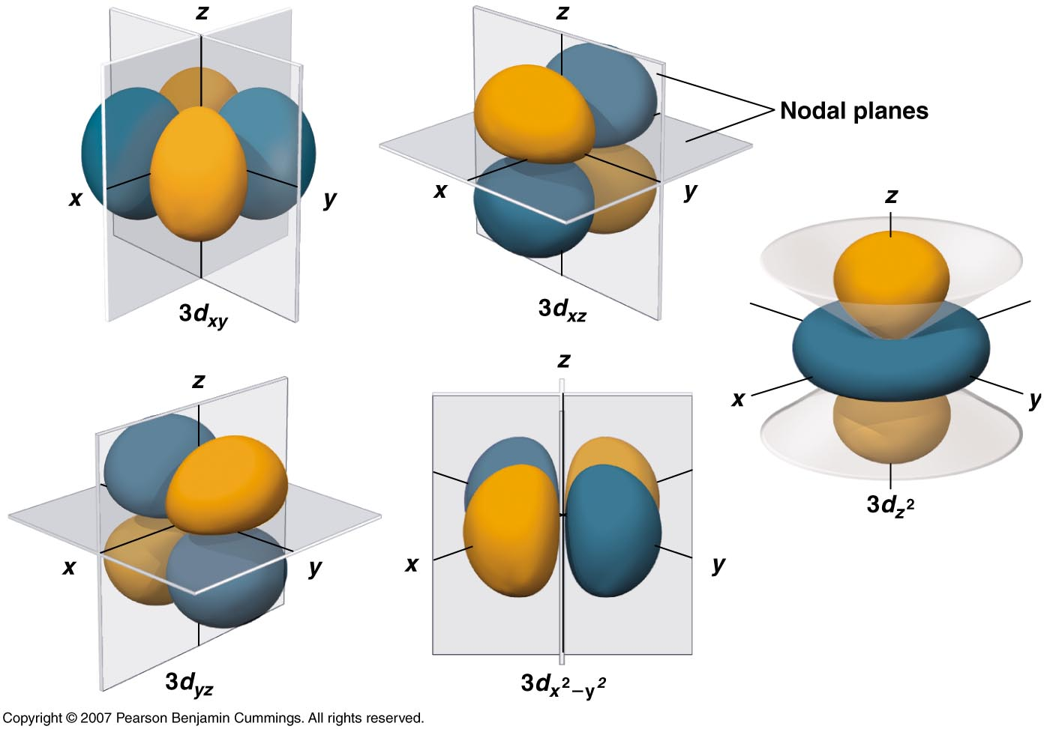
Copyright © 2006 Pearson Benjamin Cummings. All rights reserved.

Slide 74
Atomic Orbitals
A B C
Drum mode equivalent to 3d orbital
Drum mode equivalent to 4d orbital
Drum mode equivalent to 5d orbital

Slide 75
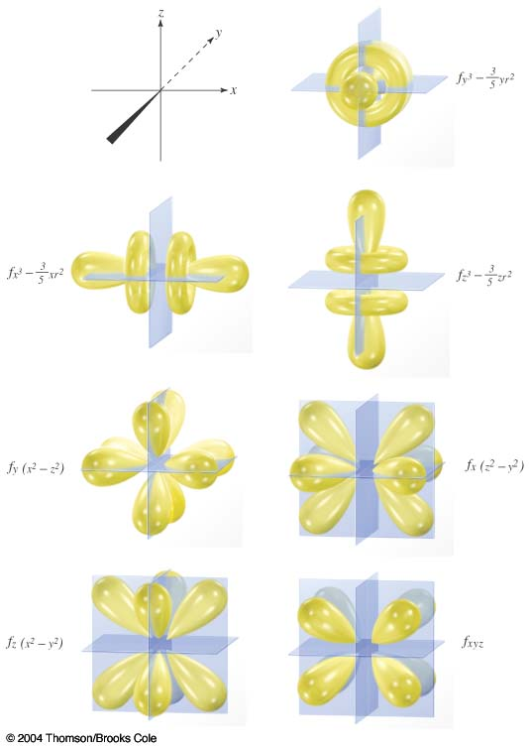
Atomic Orbitals for “f”

Slide 76
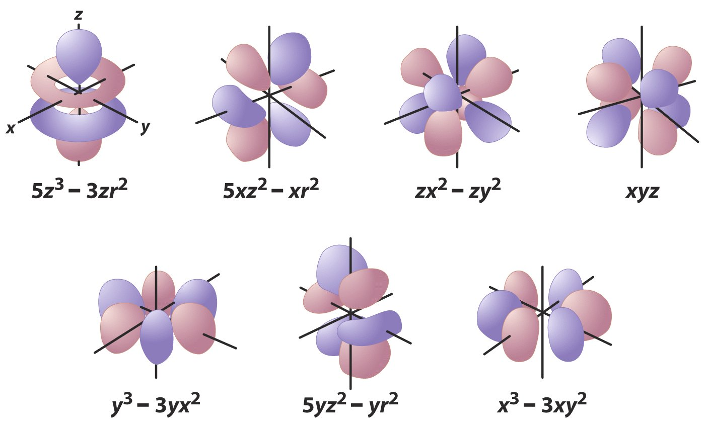
● = 3
m = -3,-2,-1,0,+1,+2, +3 7 values

Slide 77
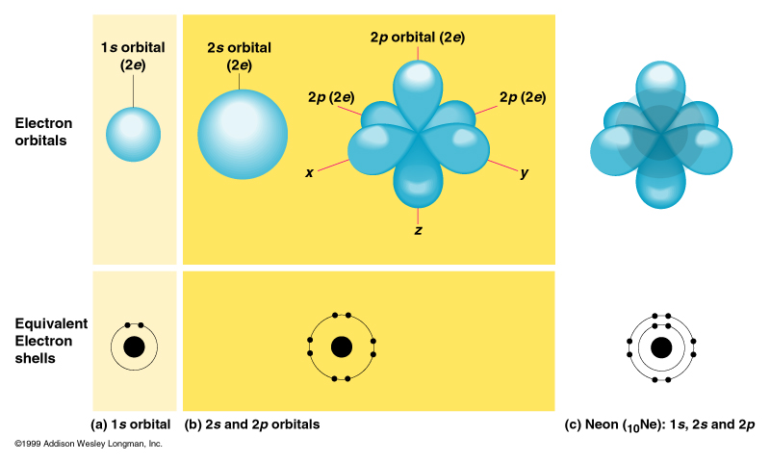
Electrons in Orbitals
2 Electrons
can go in each orbitals
Equivalent
Electron
shells
(a) 1s orbital (b) 2s and 2p orbitals
c) Neon Ne-10: 1s, 2s and 2p
1999, Addison, Wesley, Longman, Inc.

Slide 78
Ground state - electrons in lowest energy state
Excited state - electrons in a higher energy orbital
Electron configuration - how electrons are distributed in the various atomic orbitals

Slide 79
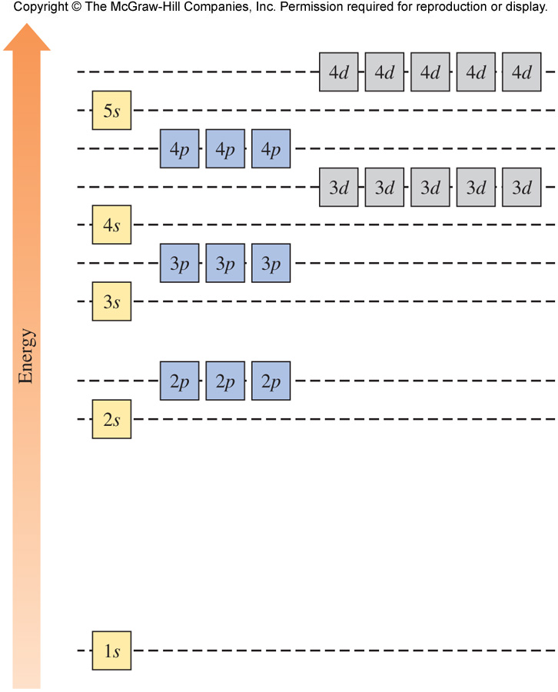
Electron Configuration - Notice the Energy for Each Orbital

Slide 80
Electron Configuration
Pauli Exclusion Principle - no two electrons in an atom can have the same four quantum numbers; no more than two electrons per orbital
Aufbau Principle - electrons fill according to orbital energies (lowest to highest)

Slide 81
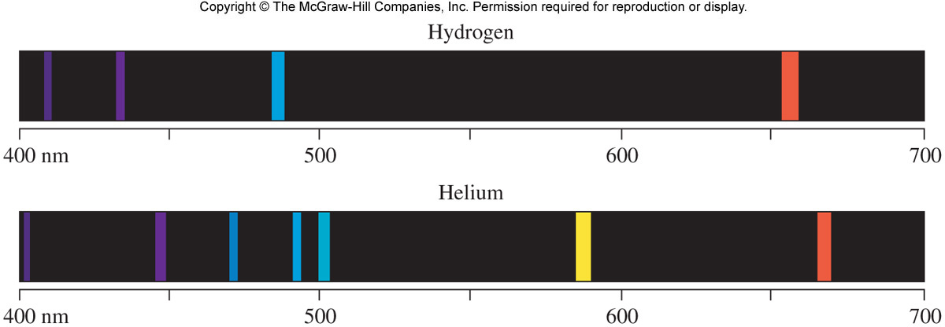
Compare the Following Emission Spectra

Slide 82
Electron Configuration
Hund’s Rule - the most stable arrangement for electrons in orbitals of equal energy (degenerate) is where the number of electrons with the same spin is maximized
Example: Carbon - 6 electrons
1s²2s²2p²

Slide 83
Rules for Writing Electron Configurations
Electrons reside in orbitals of lowest possible energy
Maximum of 2 electrons per orbital
Electrons do not pair in degenerate orbitals if an empty orbital is available
Orbitals fill in order of earlier slide (or an easy way to remember follows)‏

Slide 84
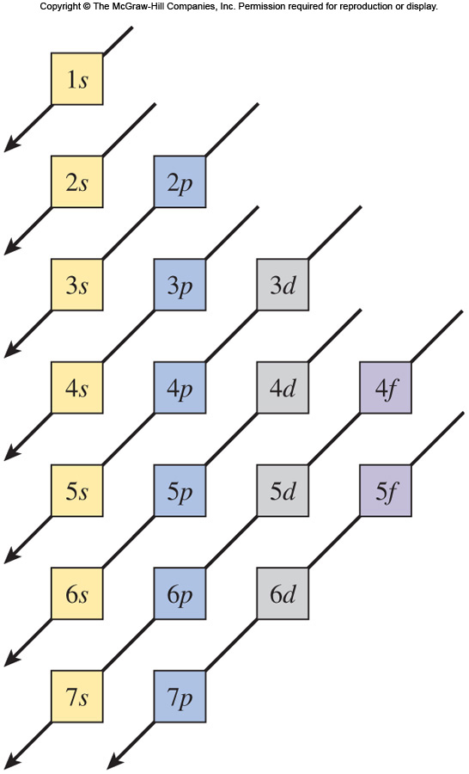
The Diagonal Rule (Aufbau Principle)

Slide 85
Practice Electron Configuration and Orbital Notation
Write the electron configuration and
orbital notation for each of the following
Z = 20
Z = 35
Z = 26

Slide 86
Z = 20 1s² 2s² 2p⁶ 3s² 3p⁶ 4s² (Ca)
1s
2s
2p
3s
3p
4s
Not very good
Z = 35 1s²2s² 2p⁶ 3s² 3p⁶ 4s² 3d¹⁰ 4p⁵ (Br)
1s
2s
2p
3s
3p
4s
3d
4p
Z = 26 1s²2s²2p⁶3s²3p⁶4s²3d⁶ (Fe)
1s
2s
2p
3s
3p
4s
3d

Slide 87
Z = 20 1s² 2s² 2p_{x}² 2p_{y}² 2p_{z}² 3s² 3p_{x}² 3p_{y}² 3p_{z}² 4s² (Ca)
1s
2s
2p
3s
3p
4s
Z = 35 1s²2s² 2p_{x}² 2p_{y}² 2p_{z}² 3s² 3p_{x}² 3p_{y}² 3p_{z}² 4s² 3d_{xy}² 3d_{xz}² 3d_{yz}² 3d_{(x2-y2)}² 3d_{(z2)}² 4p_{x}² 4p_{y}² 4p_{z}¹ (Br)
1s
2s
2p
3s
3p
4s
3d
4p
Z = 26 1s²2s² 2p_{x}² 2p_{y}² 2p_{z}² 3s² 3p_{x}² 3p_{y}² 3p_{z}² 4s²
3d_{xy}² 3d_{xz}¹ 3d_{yz}¹ 3d_{(x2-y2)}¹ 3d_{(z2)}¹ (Fe)
1s
2s
2p
3s
3p
4s
3d

Slide 88
Electron Configurations and Magnetic properties
Materials can be diamagnetic, paramagnetic and ferromagnetic
Diamagnetic (normally weak): repulsion to external magnetic field
Paramagnetic (stronger): attraction/temporal
Ferromagnetic (strong): attraction/sustained

Slide 89
Copyright © 2006 Pearson Benjamin Cummings. All rights reserved.

Slide 90
Electron Configurations and Magnetic properties
Unpaired electrons produce a net total magnetic moment
The presence of unpaired electrons is related to magnetic properties
BUT: electron configurations are related to ATOMS (NOT combinations of atoms, or even materials).

Slide 91
Z = 20 1s² 2s² 2p_{x}² 2p_{y}² 2p_{z}² 3s² 3p_{x}² 3p_{y}² 3p_{z}² 4s² (Ca)
1s
2s
2p
3s
3p
4s
Z = 35 1s²2s² 2p_{x}² 2p_{y}² 2p_{z}² 3s² 3p_{x}² 3p_{y}² 3p_{z}² 4s² 3d_{xy}² 3d_{xz}² 3d_{yz}² 3d_{(x2-y2)}² 3d_{(z2)}² 4p_{x}² 4p_{y}² 4p_{z}¹ (Br)
1s
2s
2p
3s
3p
4s
3d
4p
Z = 26 1s²2s² 2p_{x}² 2p_{y}² 2p_{z}² 3s² 3p_{x}² 3p_{y}² 3p_{z}² 4s²
3d_{xy}² 3d_{xz}¹ 3d_{yz}¹ 3d_{(x2-y2)}¹ 3d_{(z2)}¹ (Fe)
1s
2s
2p
3s
3p
4s
3d

Slide 92
Electron Configurations and the Periodic Table
Position on the periodic table indicates electron configuration
What similarities are found within groups on the table?

Slide 93
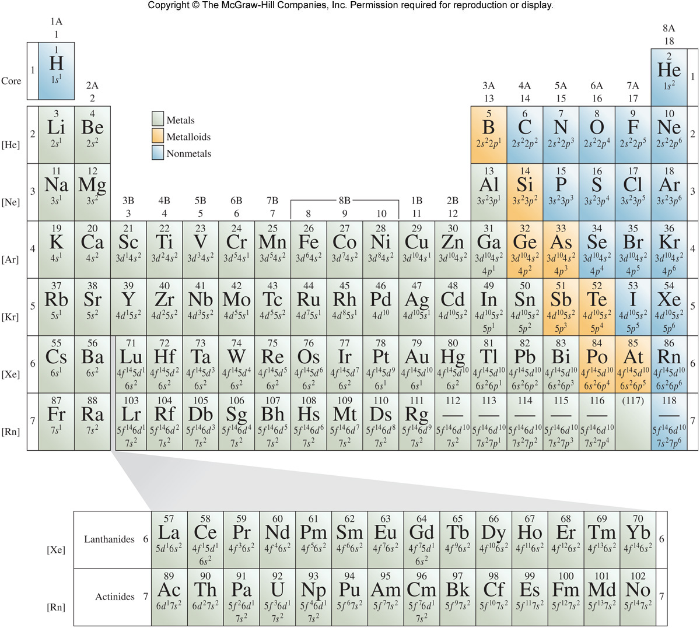

Slide 94
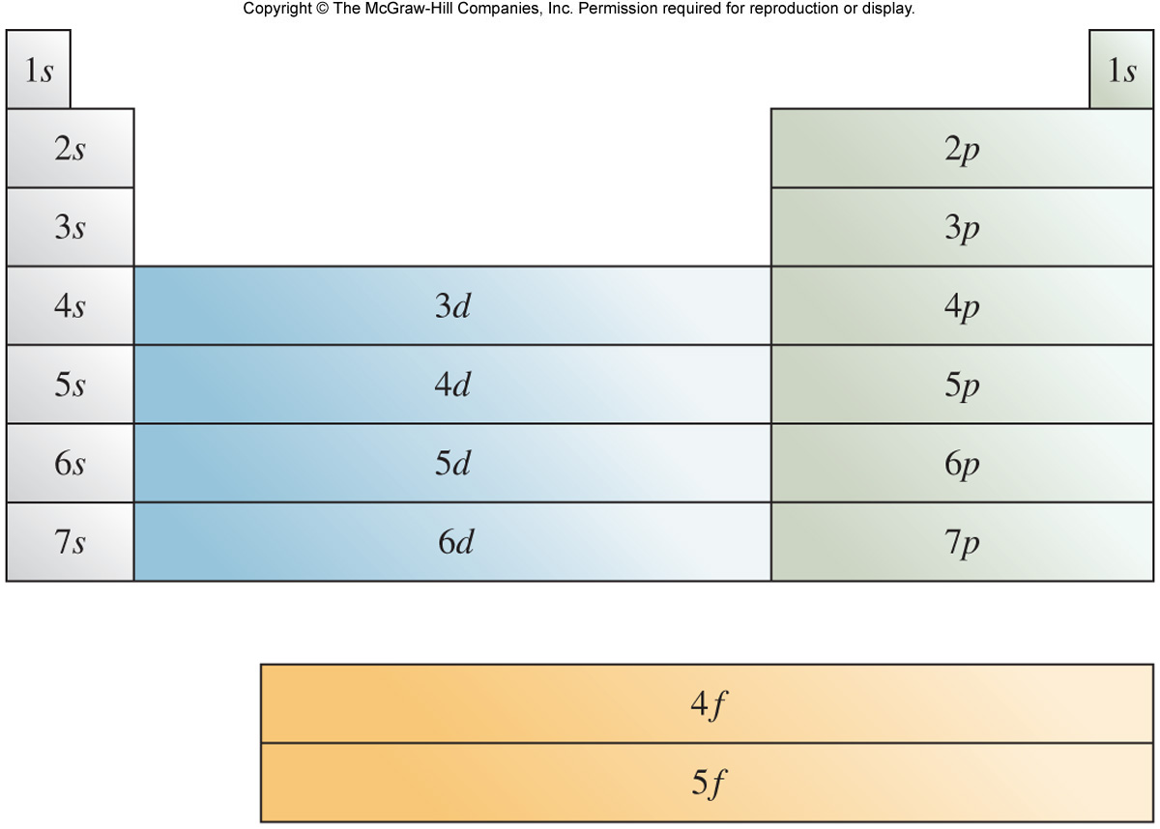

Slide 95
Electron Configurations and the Periodic Table
Noble gas core configuration - can be used to represent all elements but H and He
Example:
Z = 15 [1s²2s²2p⁶]3s²3p³ (P)
[Ne] 3s²3p³ (P)

Slide 96
The Diagonal Rule (Aufbau Principle)
Careful: The Aufbau Principle only helps you write the electron configuration. It does not tell you which electron is lost when the atom forms a cation! For example for Sc (Z= 21):
Sc 1s² 2s² 2p⁶ 3s² 3p⁶ 3d¹ 4s²
Sc⁺ 1s² 2s² 2p⁶ 3s² 3p⁶ 3d¹ 4s¹
Sc²⁺ 1s² 2s² 2p⁶ 3s² 3p⁶ 3d¹ 4s⁰
Sc³⁺ 1s² 2s² 2p⁶ 3s² 3p⁶ 3d⁰ 4s⁰

Slide 97
Diagonal Rule: Too Good to Be True?
Not all elements follow the “order” of the diagonal rule
Notable exceptions: Cu (Z = 29) and Cr (Z = 24)
Cu = [Ar]4s¹3d¹⁰
Cr = [Ar]4s¹3d⁵
Reason: slightly greater stability associated with filled and half-filled d subshells

Slide 98
Exceptions to the Aufbau principle
Chromium (Cr) | [Ar] 3d⁵ 4s¹
Copper (Cu) | [Ar] 3d¹⁰ 4s¹
Niobium (Nb) | [Kr] 4d⁴ 5s¹
Molybdenum (Mo) | [Kr] 4d⁵ 5s¹
Ruthenium (Ru) | [Kr] 4d⁷ 5s¹
Rhodium (Rh) | [Kr] 4d⁸ 5s¹
Palladium (Pd) | [Kr] 4d¹⁰ 5s⁰
Silver (Ag) | [Kr] 4d¹⁰ 5s¹
Lanthanum (La) | [Xe] 5d¹ 6s²
Cerium (Ce) | [Xe] 4f¹ 5d¹ 6s²
Gadolinium (Gd) | [Xe] 4f⁷ 5d¹ 6s²
Platinum (Pt) | [Xe] 4f¹⁴ 5d⁹ 6s¹
Gold (Au) | [Xe] 4f¹⁴ 5d¹⁰ 6s¹
Actinium (Ac) | [Rn] 6d¹ 7s²
Thorium (Th) | [Rn] 6d² 7s²
Protactinium (Pa) | [Rn] 5f² 6d¹ 7s²
Uranium (U) | [Rn] 5f³ 6d¹ 7s²
Neptunium (Np) | [Rn] 5f⁴ 6d¹ 7s²
Curium (Cm) | [Rn] 5f⁷ 6d¹ 7s²
In red: half or full d/f subshell

